Slide 1


introduction,
searching,
insertion and
deletion

Slide 2
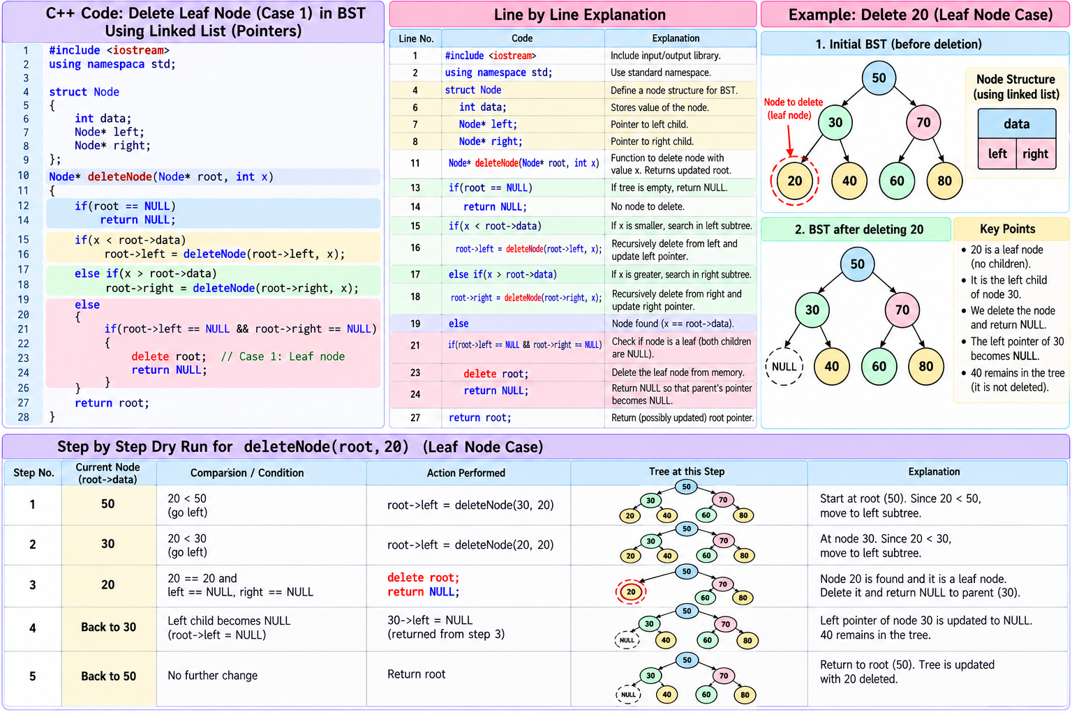
Tree Using Linked List - Delete

Slide 3
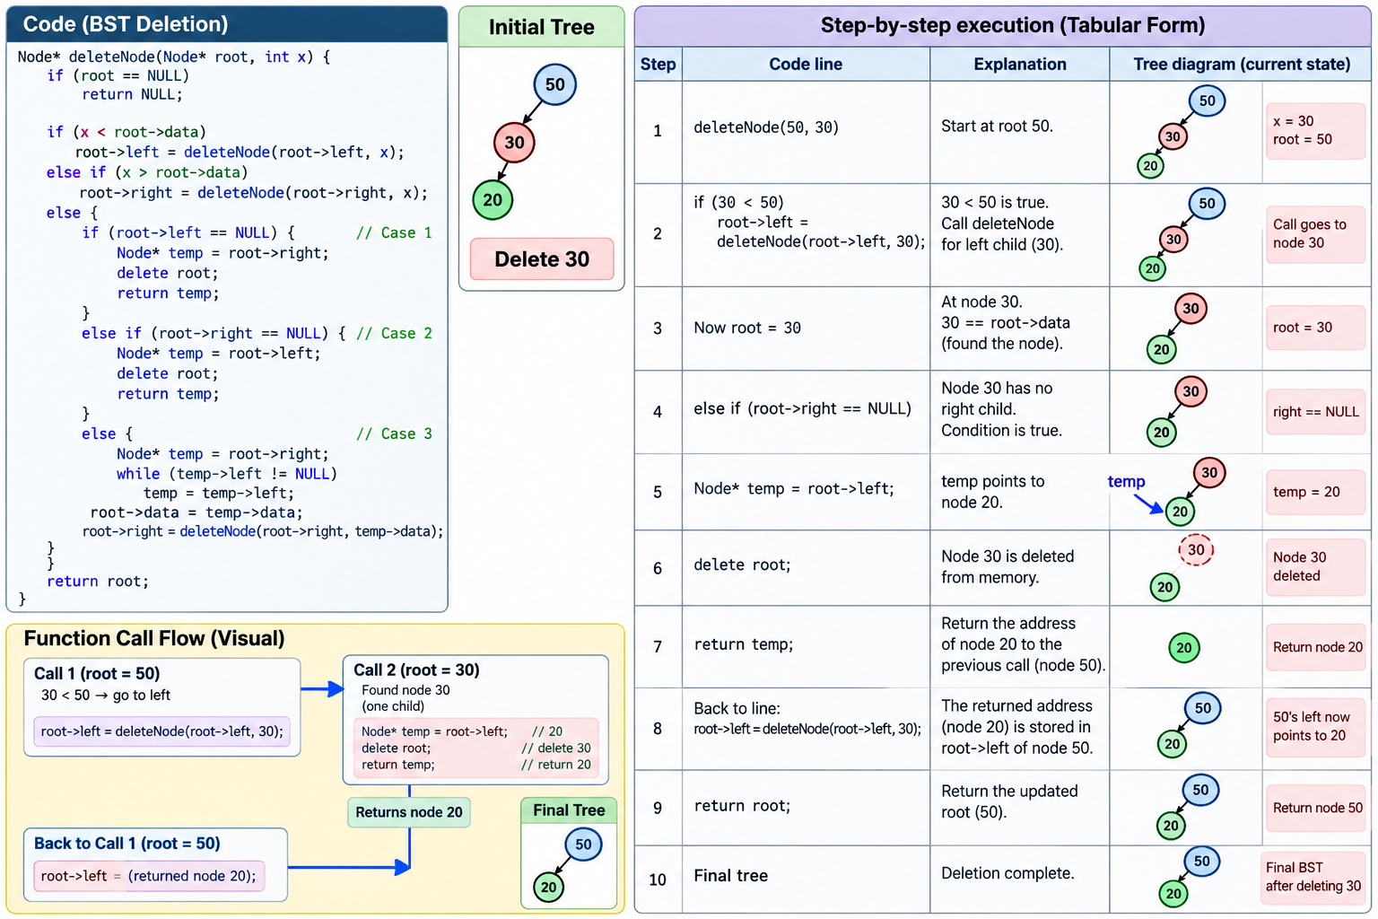
Tree Using Linked List - Delete

Slide 4
Tree Using Linked List - Delete
#include <iostream>
using namespace std;
struct Node
{
int data;
Node* left;
Node* right;
};
Node* deleteNode(Node* root, int x)
{
if(root == NULL)
return NULL;
if(x < root->data)
root->left = deleteNode(root->left, x);
else if(x > root->data)
root->right = deleteNode(root->right, x);
else
{
// Case 1: No children (leaf node)
if(root->left == NULL && root->right == NULL)
return NULL;
// Case 2: Only right child
if(root->left == NULL)
return root->right;
// Case 2: Only left child
if(root->right == NULL)
return root->left;
// Case 3: Two children
Node* temp = root->right;
while(temp->left != NULL)
temp = temp->left;
root->data = temp->data;
root->right = deleteNode(root->right, temp->data);
}
return root;
}

Slide 5
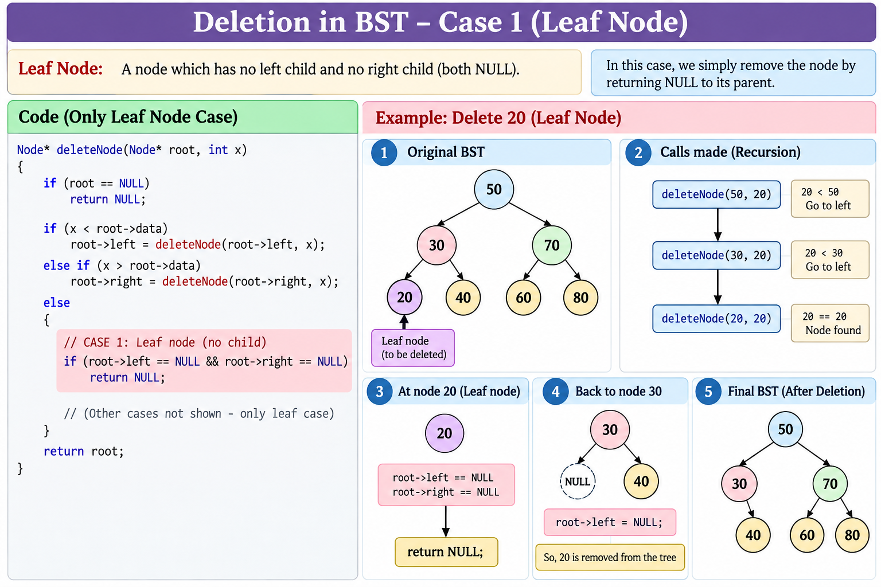
Tree Using Linked List - Delete

Slide 6
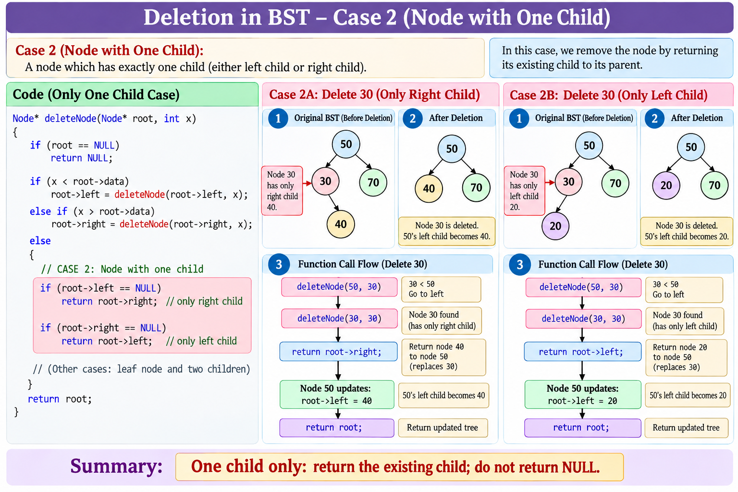
Tree Using Linked List - Delete

Slide 7
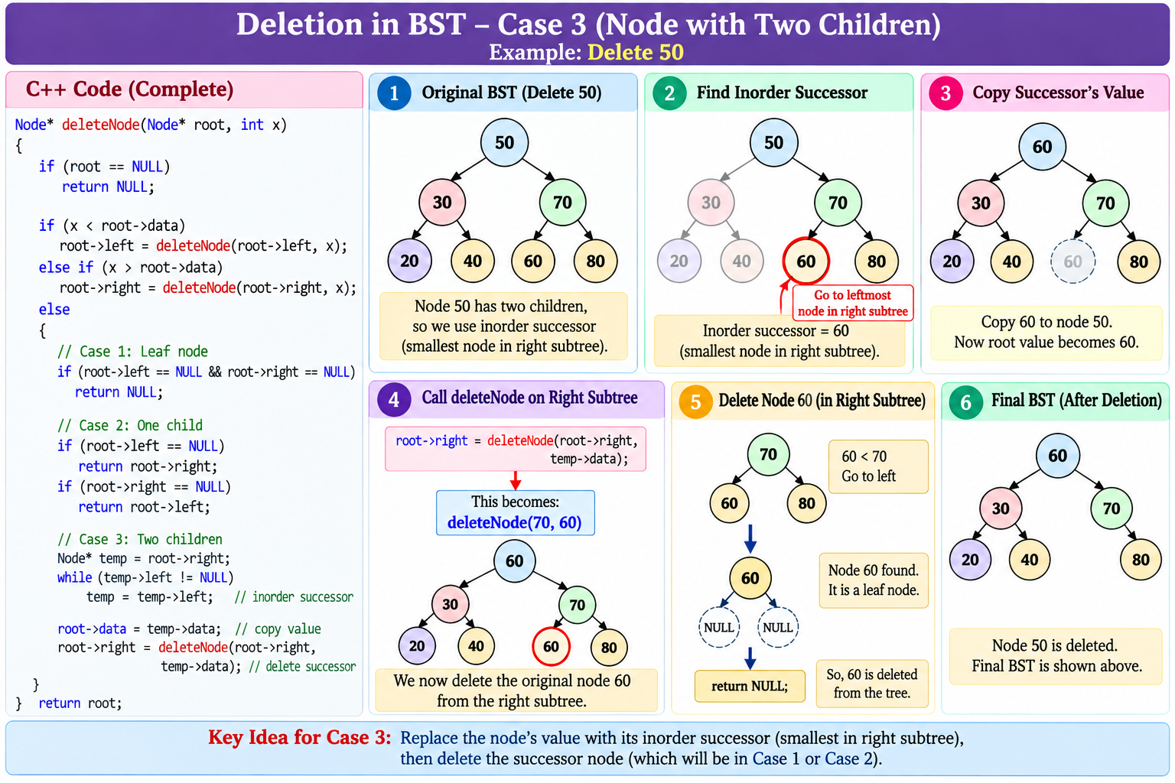
Tree Using Linked List - Delete

Slide 8
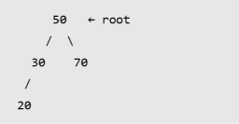
Tree Using Linked List - Delete
Node* deleteNode(Node* root, int x)
{
// If node does not exist, stop
if(root == NULL)
return NULL;
// Example: Delete 30 from root 50
// 30 < 50, so search on the left
if(x < root->data)
root->left = deleteNode(root->left, x);
// Example: Delete 70 from root 50
// 70 > 50, so search on the right
else if(x > root->data)
root->right = deleteNode(root->right, x);
else
{
// CASE 1: No child
// Example: Delete 20
// 30
// /
// 20
// 20 has no children, so remove it
if(root->left == NULL && root->right == NULL)
return NULL;
// CASE 2: Only right child
// Example: Delete 30 when its only child is 40
// 30
// \
// 40
// Return 40 in place of 30
if(root->left == NULL)
return root->right;
// CASE 2: Only left child
// Example: Delete 30 when its only child is 20
// 30
// /
// 20
// Return 20 in place of 30
if(root->right == NULL)
return root->left;
// CASE 3: Two children
// Example: Delete 50
// 50
// / \
// 30 70
// / \
// 60 80
// Start from right child (70)
Node* temp = root->right;
// Find the smallest value on the right
// Here, temp becomes 60
while(temp->left != NULL)
temp = temp->left;
// Replace 50 with 60
root->data = temp->data;
// Delete the original 60 node
root->right = deleteNode(root->right, temp->data);
}
// Return the updated tree
return root;
}

Slide 9

